Slide 1



Internship Learning Summary: Full-Stack Development
Yash Technology | May - July

Slide 2
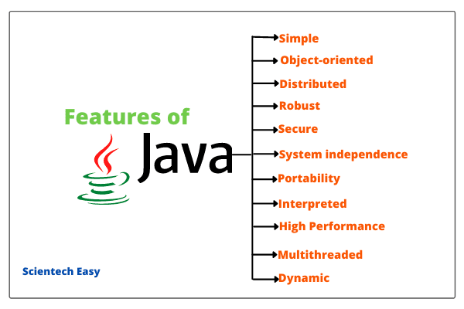
Java Fundamentals:

Slide 3
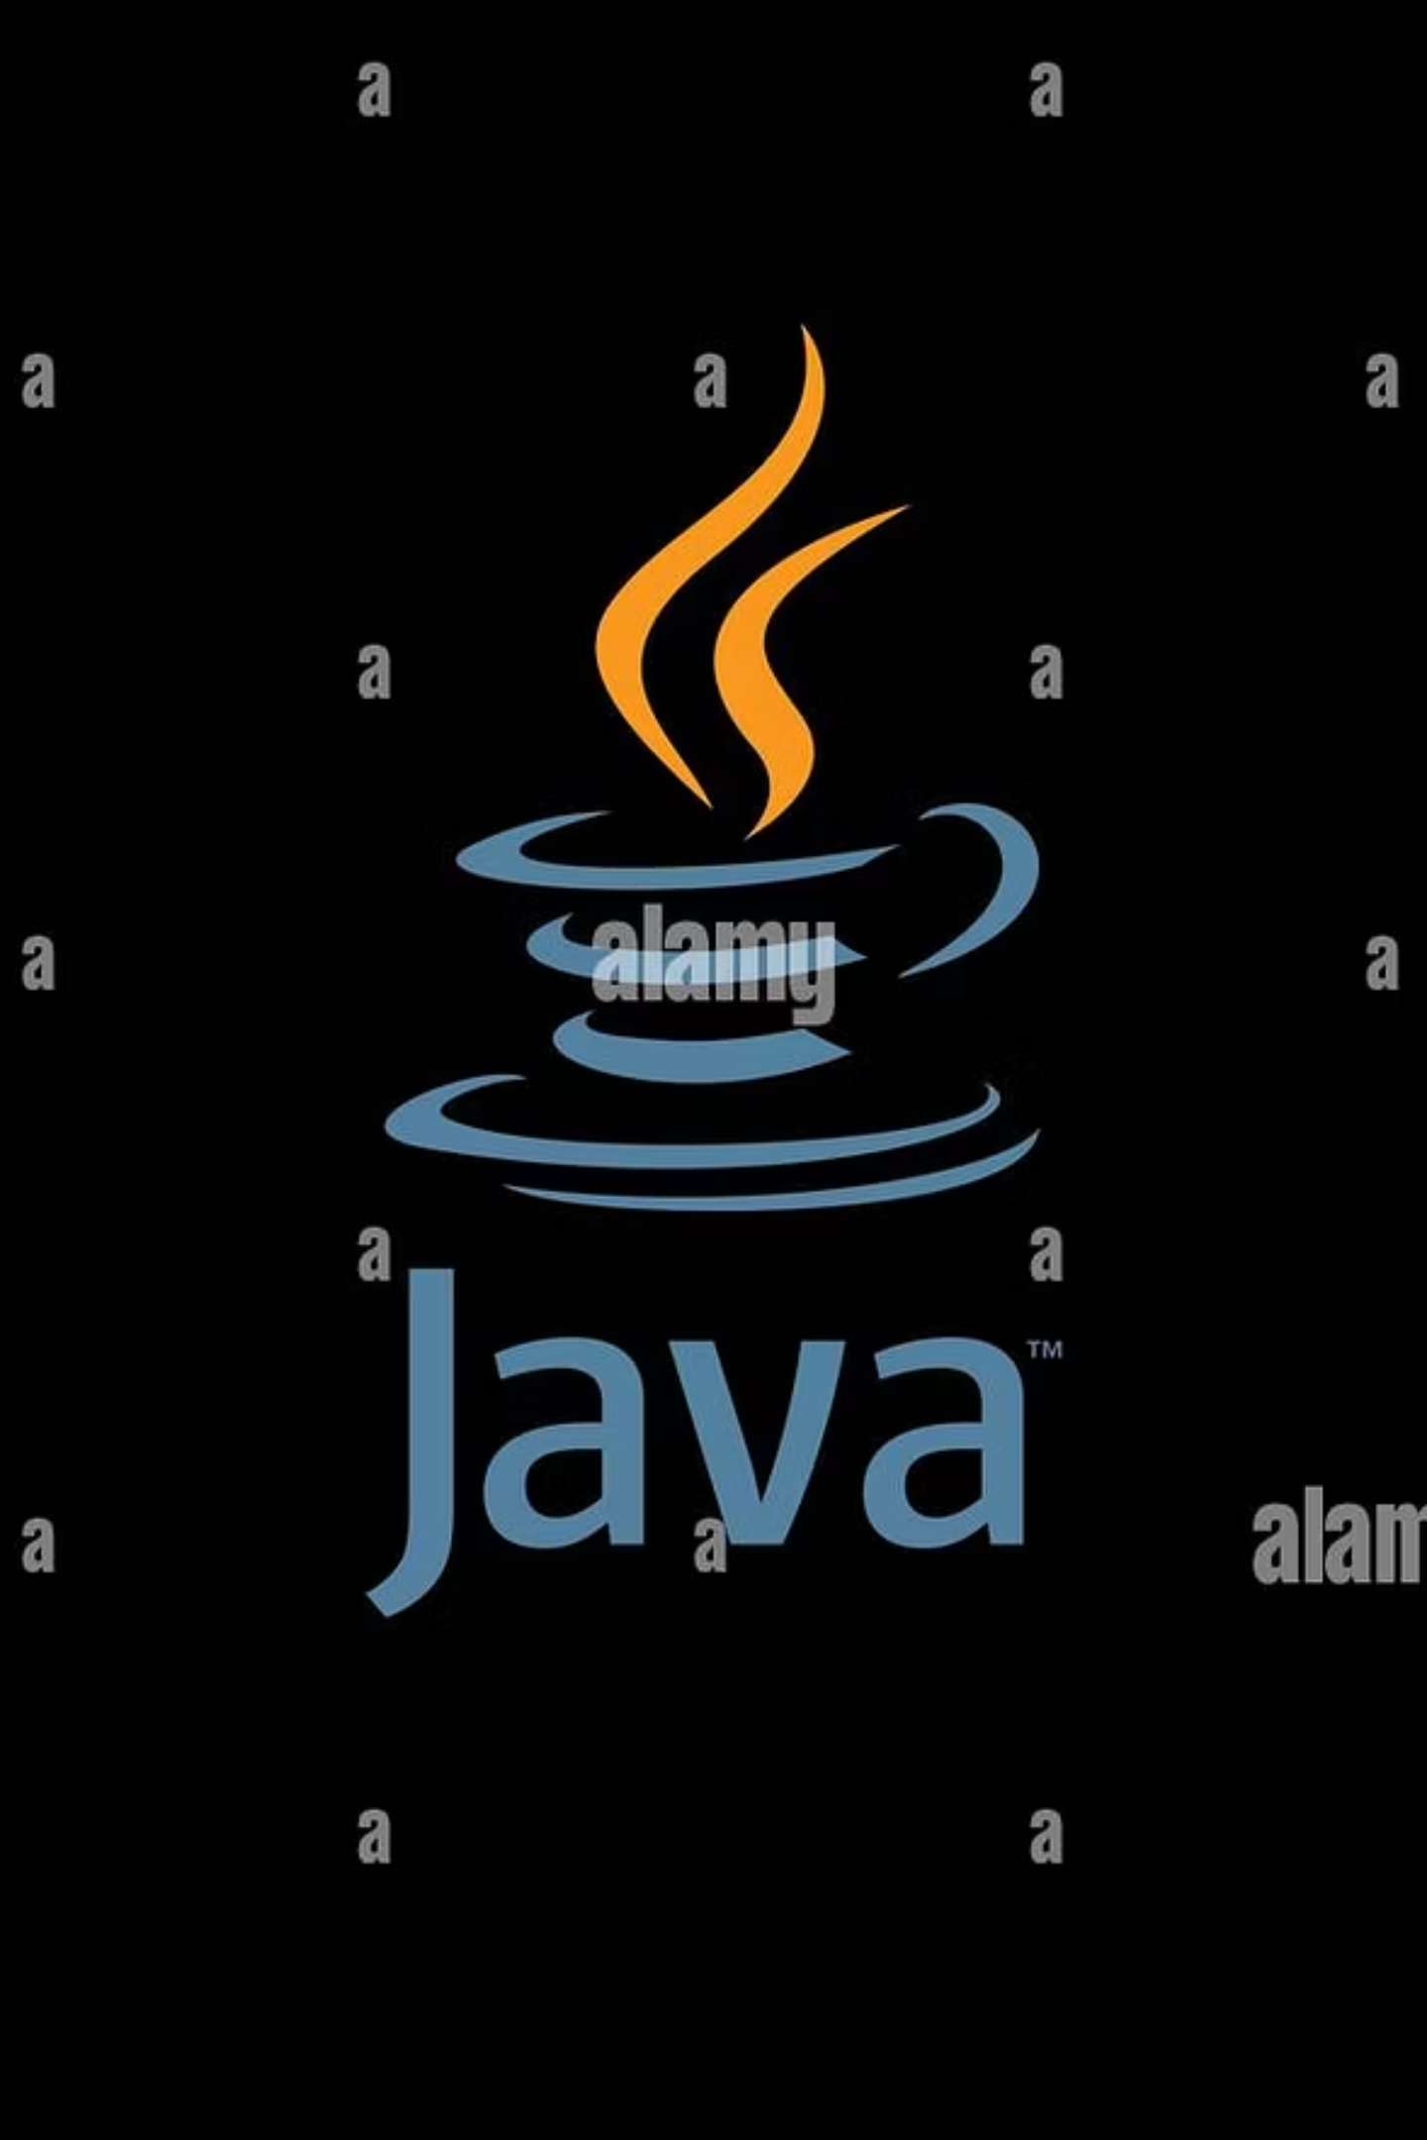




Java Fundamentals: Object-Oriented Mastery
Four Pillar of O O P S
Inheritance, Polymoriphsm, Encapsulation & Abstraction
Collection Framework
Concept of LinkedList, HashMap & many more
Multi Threading
Multiple Threads Running Simultaneously
Exception Handling
Handle Error by using try catch block

Slide 4


Java Fundamentals: Before Java 8 Features
List<String> names = Arrays.asList(“Keshav", “Ram", “Ravi“);
List<String> filterMap = new ArrayList<>();
for (String name : names) {
if (name.startsWith("A")) {
filterMap.add(name);

Slide 5

Java 8 Feature
List<String> names = Arrays.asList(“Keshav", “Aman", "Anna");
names.stream().filter(name -> name.startsWith("A"))
.map(name -> name.toUpperCase())
.forEach(name -> System.out.println(name));
}
}

Slide 6
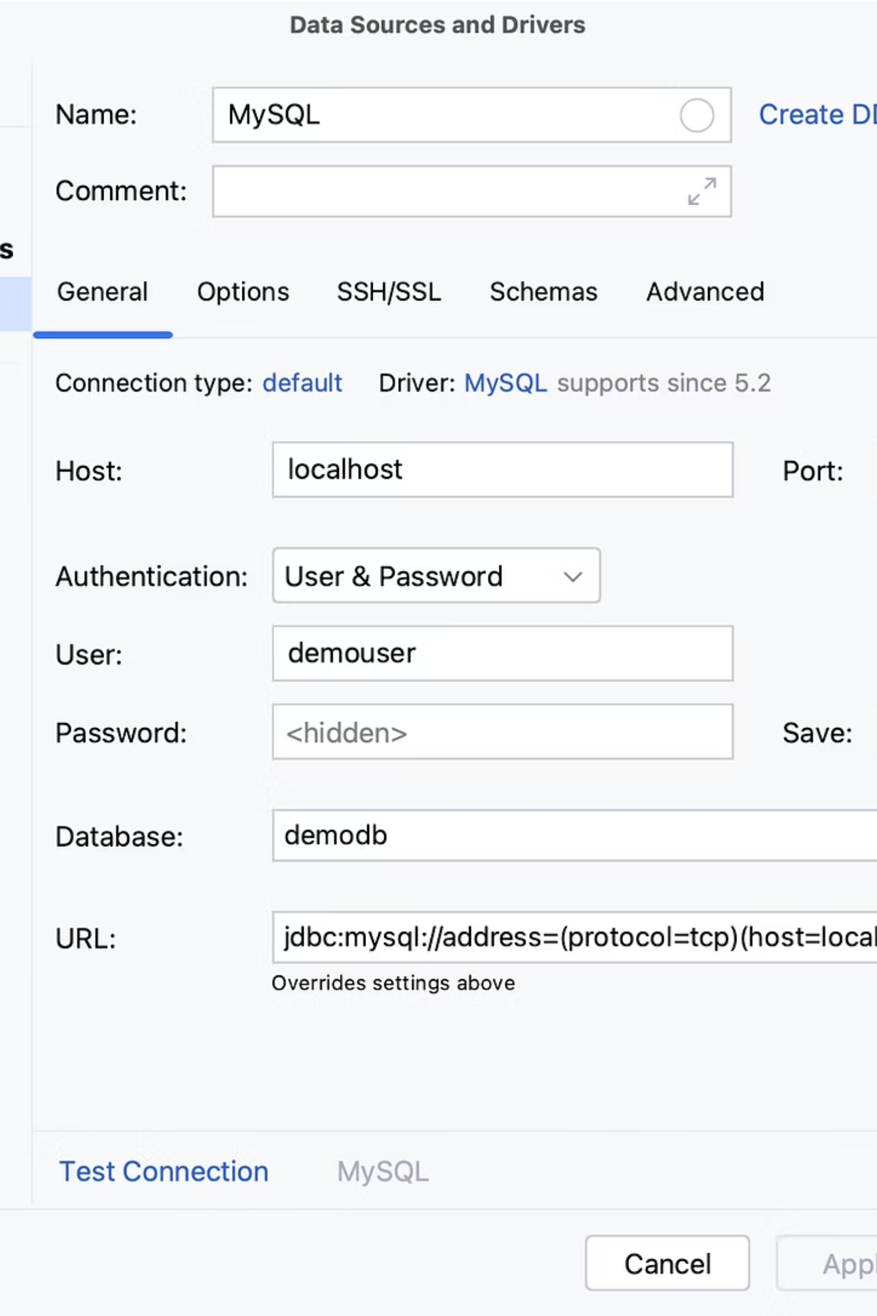
Backend Core: JDBC & Servlet Applications
Servlet:
Handles HTTP requests/responses
Runs on server (e.g., Tomcat)
Works with JSP/HTML
JDBC:
Connect Java to Database
Performs CRUD with SQL
Uses Connection, Statement and ResultSet
Used in Login , registration and CRUD operation.
Servlet get input -> JDBC access DB.

Slide 7
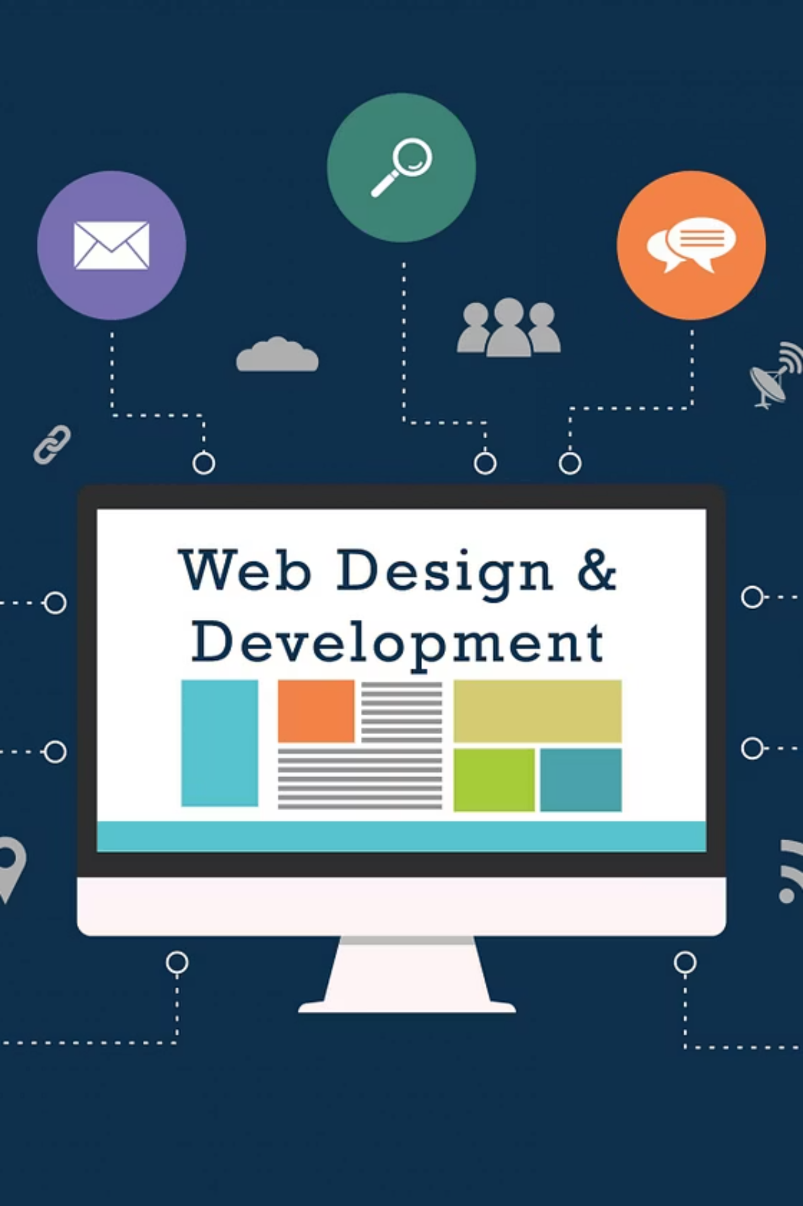
Frontend Integration: Dynamic JSP Pages
JSP
Provide Dynamic Web Interface
Form Handling
Processed User Form
MVC Pattern
Separated Logic
Session Management
Built-in support for handling user sessions

Slide 8
Project: Contact Manager
Technologies Used:
JSP : UI for forms and displaying contact data
Servlets : Handles form submissions, business logic
JDBC : Connects to database for CRUD operations
MySQL / Oracle : Stores contact info
Core Features:
Add new contact
View all contacts
Update contact details
Delete contact
User login & session management

Slide 9

Framework Mastery: Spring Boot Ecosystem
Spring Boot
Spring Data JPA
Simplifies Spring application setup with auto-configuration.
Eases database access by reducing boilerplate using JPA repositories.
REST APIs
Dependency Injection
Secure endpoints with Spring Security
Managed components for scalability

Slide 10

Project: ElectroHub Store
Currently building with Spring Boot
E-commerce Platform
Technologies
Online store for electronics
Spring Boot, Spring Data JPA, Spring MVC
Key Features
Learning Focus
Product catalog, shopping cart, user authentication
Scalability, security, modern web practices

Slide 11
Thank you

